Slide 1
Presented by
Contact Book
Julian Bir
Personal Contact Manager
Judhy Germain
Bouchard
COP4331 – Small Project | Spring 2026
Damien Way

Slide 2
Meet the Team
Each member's role in Contact Book
JB
JG
CS
DW
Julian Bir
Judhy Germain Bouchard
Christopher Saladini
Damien Way
Front-End Developer
Project Manager
Database Manager
API Developer
Front-End Developer
API Developer

Slide 3
Problem Statement
Defining the what, why, and scope
The Problem
Our Solution
People need a reliable, private way to manage their personal contacts. Existing solutions either share data across users, lack proper security, or require complex third-party accounts with no real user ownership.
There is no simple, self-contained web application that gives each person a fully private contact list they control completely.
Private account per user: register, log in, no shared data
Full CRUD: add, view, search, edit, and delete contacts
Server-side partial-match search, fast and secure
AJAX-enabled web client: smooth, page-free experience
Fully documented REST API via SwaggerHub
Live at coppoosd.com on DigitalOcean
Scope: Single-user web app. One person, one account, private contacts.

Slide 4
















Technology Used
Communications
Source Code & PM
Front End
HTML5
CSS3
JavaScript
Discord
GitHub
Jira
Figma
Back End
Database & Hosting
Dev Tools & APIs
Postman
SwaggerHub
VS Code
PHP
Apache
MySQL
DigitalOcean
Claude AI
ChatGPT

Slide 5
System Use Cases
User interactions with the Contact Manager

Slide 6
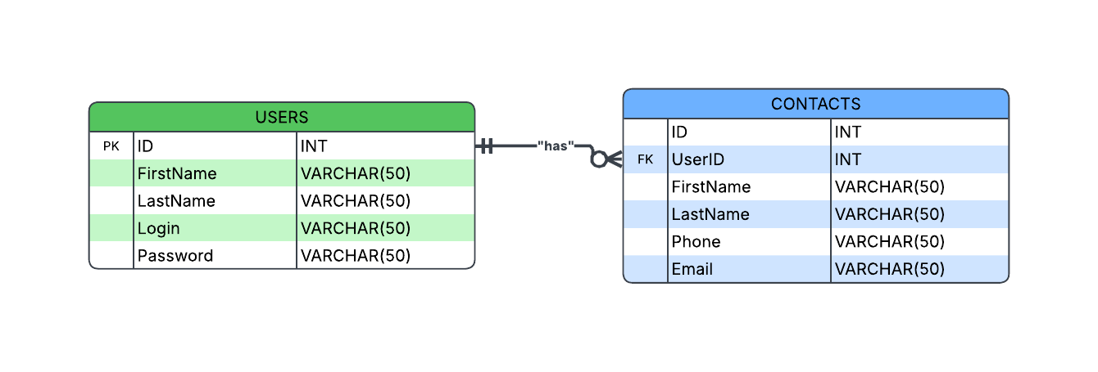
Entity Relationship Diagram
USERS and CONTACTS — 1:N relationship via foreign key
One user has many contacts — contacts are private per user.

Slide 7
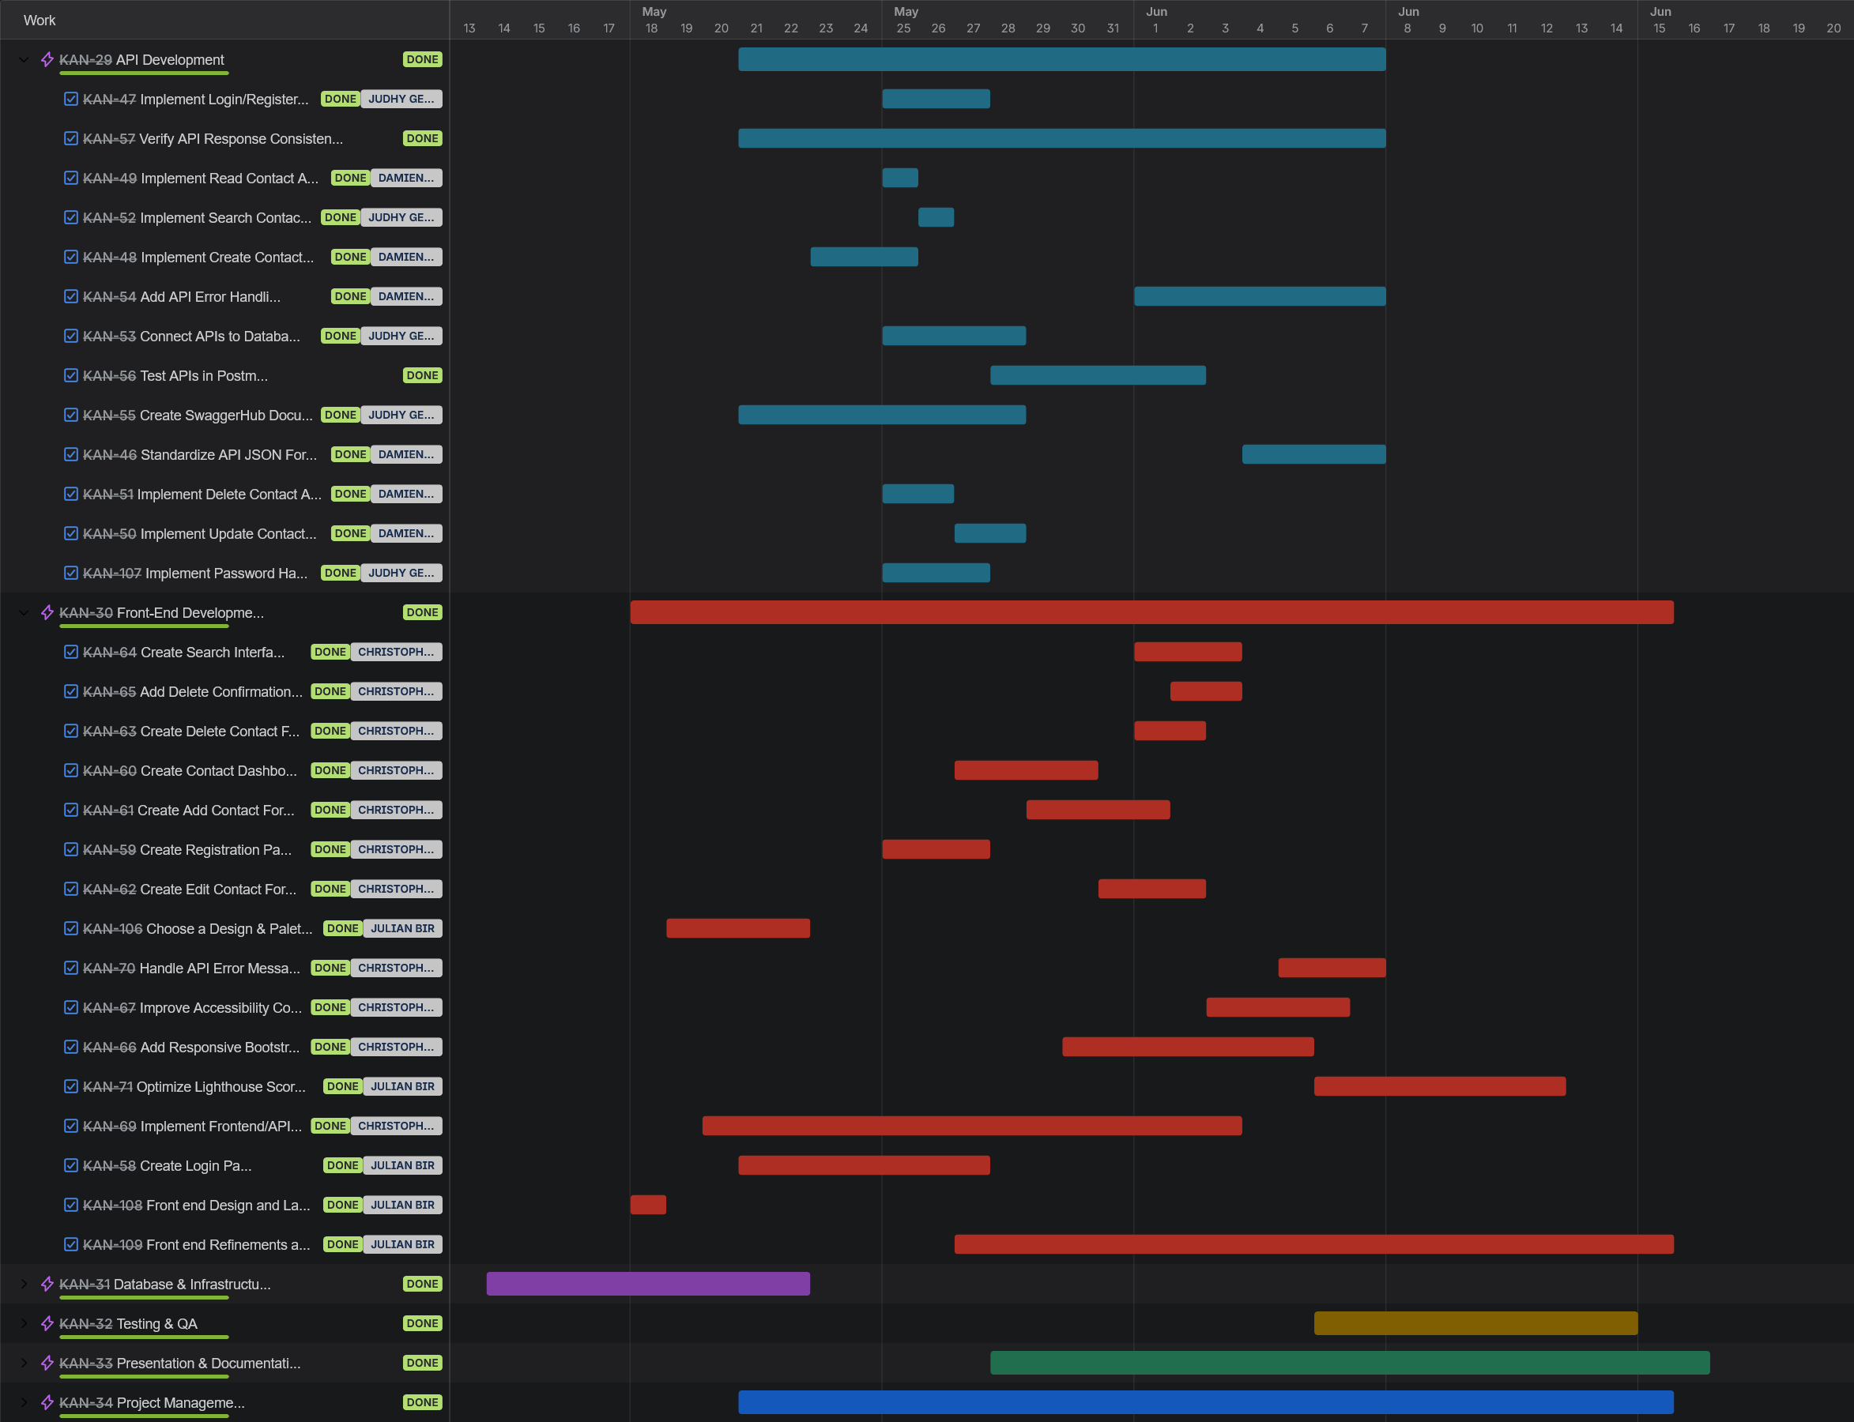
Gantt Chart
Project timeline — Jira

Slide 8
API Demo
SwaggerHub API Documentation
Login / Registration API Demonstration
All endpoints available: login · create · read · search · update · delete

Slide 9
Application Demo
Live Application
coppoosd.com

Slide 10
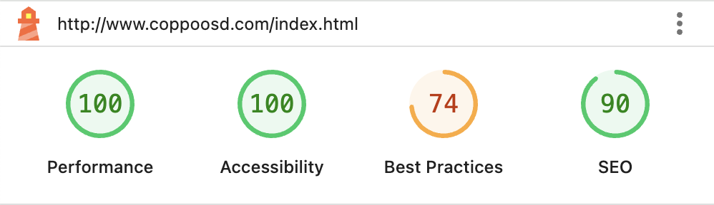
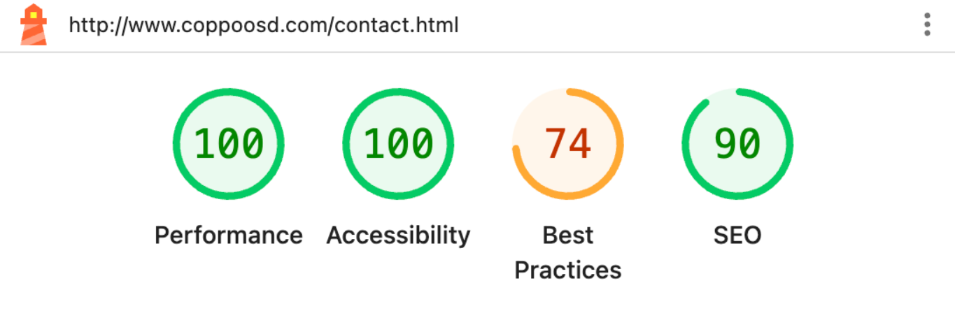
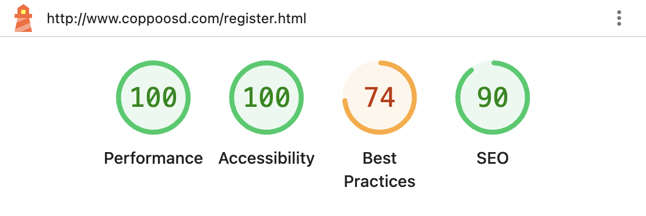
Lighthouse Report
Making sure Contact Book is accessible to all

Slide 11
What Went Well
Reflecting on our team's strengths
Regular Team Meetings
Clear Role Expectations
Held meetings after lectures most days, keeping everyone aligned and problems solved quickly.
Everyone knew their responsibilities upfront, reducing overlap and confusion across the team.
✓
✓
Jira Kept Us on Track
Proactive Tool Learning
Learning and adopting Jira helped the team monitor progress and stay organized throughout.
Members unfamiliar with tools like SwaggerHub took initiative to learn, keeping momentum high.
✓
✓

Slide 12
Challenges & Lessons Learned
Areas where we adapted and what we'd do differently
Time Zone & Communication Challenge
!
One team member was deployed in a later time zone, making real-time communication less than ideal. Scheduling synchronous check-ins required flexibility, and async updates became the primary collaboration mode.
Lesson Learned
Establishing async-first workflows — documented updates, clear Jira tickets, recorded decisions — earlier would have smoothed coordination across time zones from the start.

Slide 13
?
Questions?
Thank you for listening!
coppoosd.com • github.com/Ayloonah/POOSD-Group-Project

